Slide 1
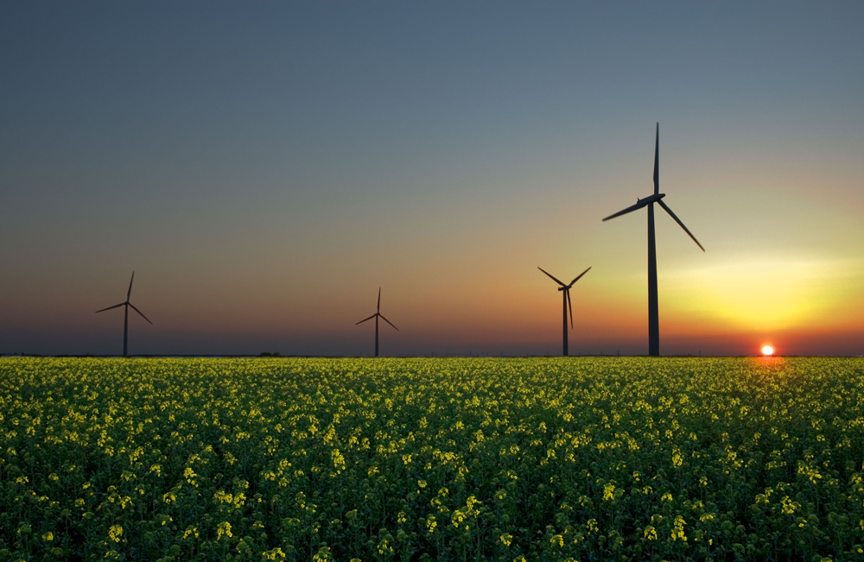
Chapter 7 WORK, ENERGY, AND ENERGY RESOURCES
How many forms of energy can you identify in this photograph of a wind farm in a soybean field?

Slide 2
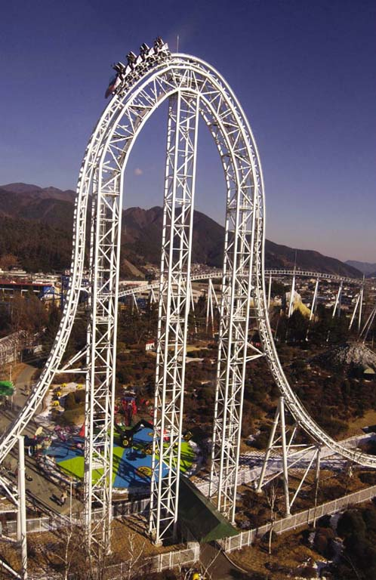
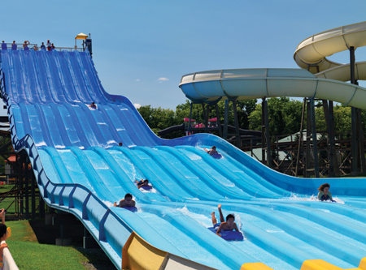
Energy Transformation

Slide 3
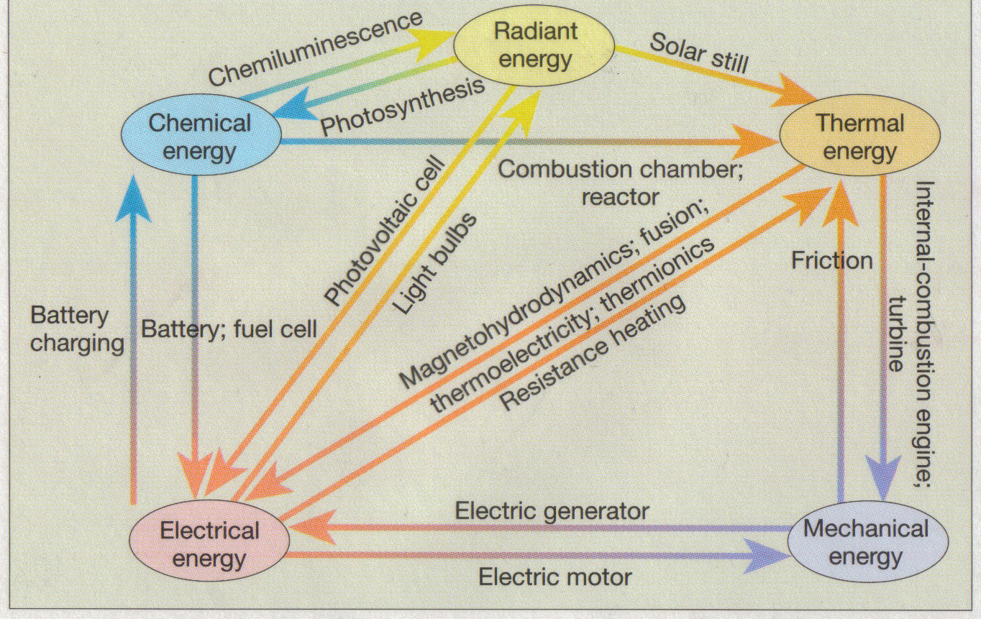
Energy: Forms and Transformations

Slide 4
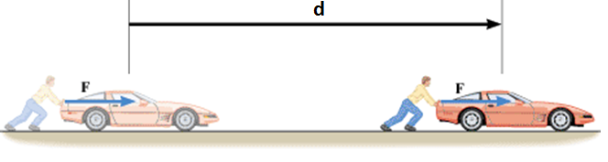
Work Done by a Constant Force
Work is done when a force F pushes a car through a displacement d.
Work = Force X Displacement.
SI Unit of Work: joule, J Work is a scalar.

Slide 5
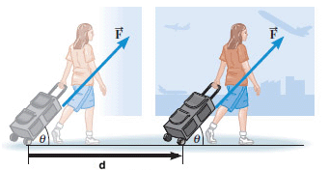
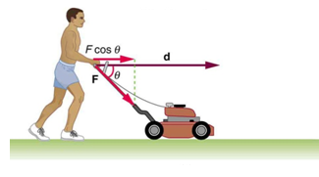
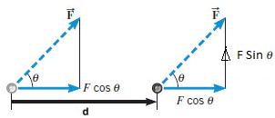
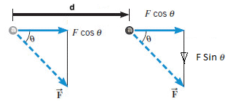

What if the force is not along the displacement?
Use the component of the force along the displacement.
What is the work done by Fsinθ?
What is accomplished by Fsinθ?

Slide 6
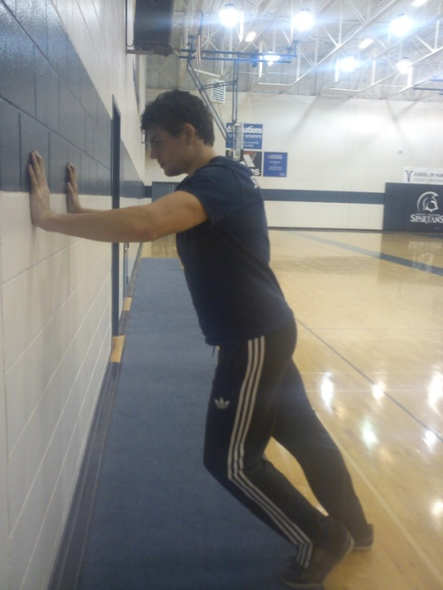
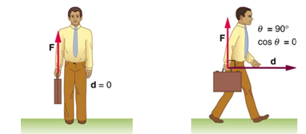
Examples of zero work

Slide 7
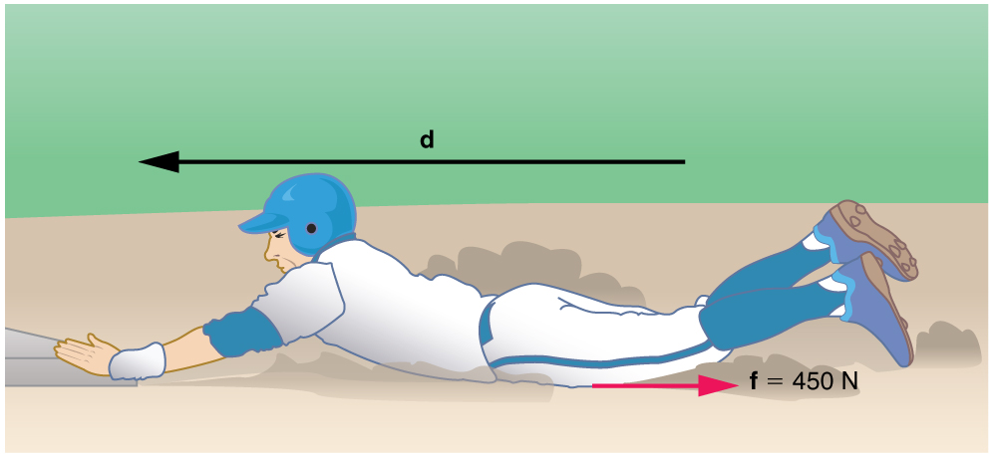
Negative Work
Frictional forces do negative work.
The baseball player slides to a stop in a distance d . In the process, friction removes the player’s kinetic energy by doing an amount of negative work fd equal to the initial kinetic energy.

Slide 8
Units
System | Force | Distance | Work
SI | newton (N) | meter (m) | N·m = joule (J)
CGS | dyne | cm | dyn·cm = erg
BE/USC | pound (lb) | foot (ft) | foot·pound (ft·lb)

Slide 9
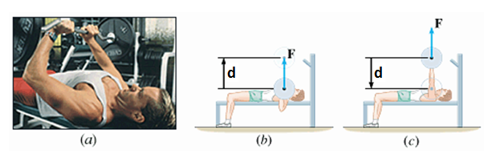
Bench Pressing
During bench-pressing work is done against gravity

Slide 10
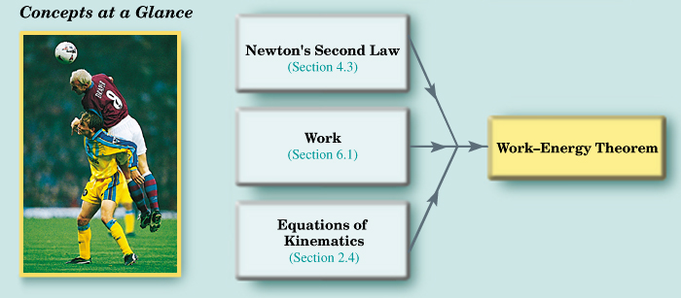
The Work-energy Theorem and Kinetic Energy

Slide 11
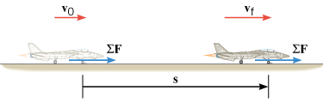

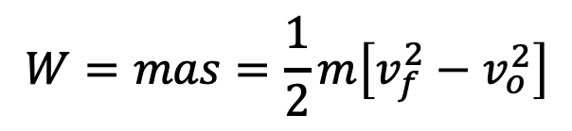

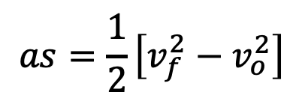



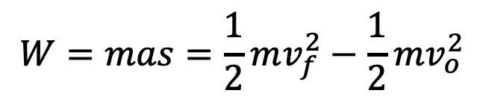
Work-Energy Theorem and Kinetic Energy
$$W=ΣF×s$$
$$ΣF=ma$$
$$W=ma×s=mas$$
$$v_{f}^{2}=v_{o}^{2}+2as$$
$$2as=v_{f}^{2}−v_{o}^{2}$$
$$as=\frac{1}{2}\left[v_{f}^{2}−v_{o}^{2}\right]$$
$$W=mas=\frac{1}{2}m\left[v_{f}^{2}−v_{o}^{2}\right]$$
$$W=mas=\frac{1}{2}mv_{f}^{2}−\frac{1}{2}mv_{o}^{2}$$
Kinetic Energy is a scalar.
SI Unit of Kinetic Energy: joule (J)

Slide 12
Gravitational Potential Energy
The gravitational potential energy PE is the energy that an object of mass m has by virtue of its position relative to the surface of the earth. That position is measured by the height h of the object relative to an arbitrary zero level:
Gravitational Potential Energy is a scalar.
SI Unit of Gravitational Potential Energy: joule (J)

Slide 13
Conservative and Non-conservative Forces
A force is a conservative force if the net work it does on a particle moving around any closed path, from an initial point and then back to that point, is zero.
Equivalently, a force is conservative if the net work it does on a particle moving between two points does not depend on the path taken by the particle.
A force is non-conservative if the net work it does on a particle moving between two points does depend on the path taken by the particle.

Slide 14
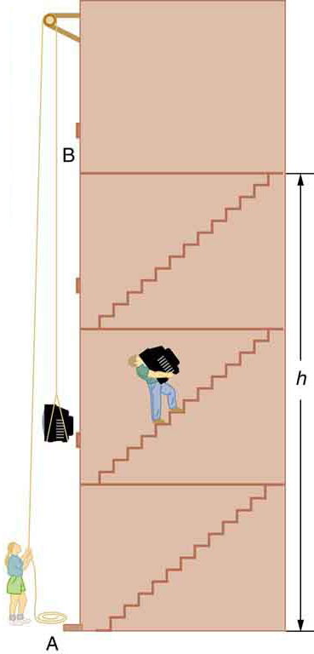
Examples
Conservative Forces
Gravitational force
Elastic spring force
Electric force
Nonconservative Forces
Static and kinetic frictional forces
Air resistance & Drag
Tension
Normal force
Propulsion force of a rocket

Slide 15
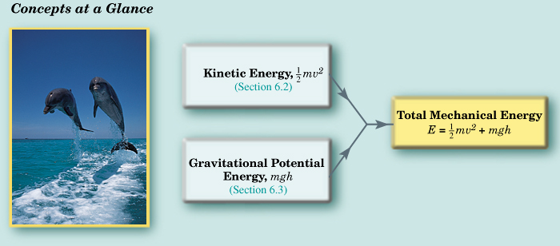
The Conservation of Mechanical Energy

Slide 16
THE PRINCIPLE OF CONSERVATION OF MECHANICAL ENERGY
The total mechanical energy (E = KE + PE) of an object remains constant as the object moves, provided that the net work done by external nonconservative forces is zero.

Slide 17
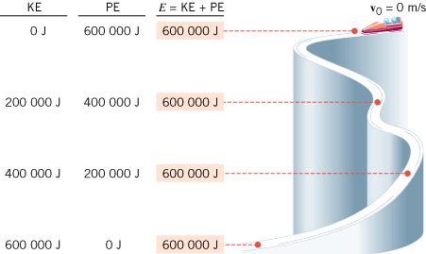
Conservation of Mechanical Energy
If friction and wind resistance are ignored, a bobsled run illustrates how kinetic and potential energy can be inter converted, while the total mechanical energy remains constant.

